Slide 1

How to Really use Udio Part 3

Slide 2
What is covered
What is Udio?
Getting Started
A Tour of the Environment
The Importance of Good Prompts
Creating Music
Working with Advanced Features
Remixing
Extending

Slide 3
The importance of good prompts

Slide 4
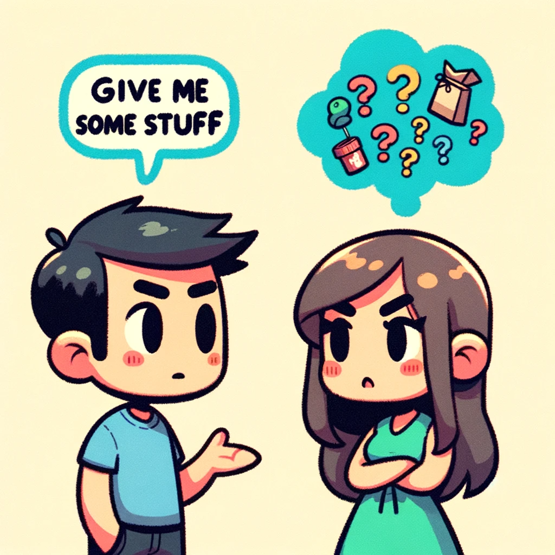

Slide 5
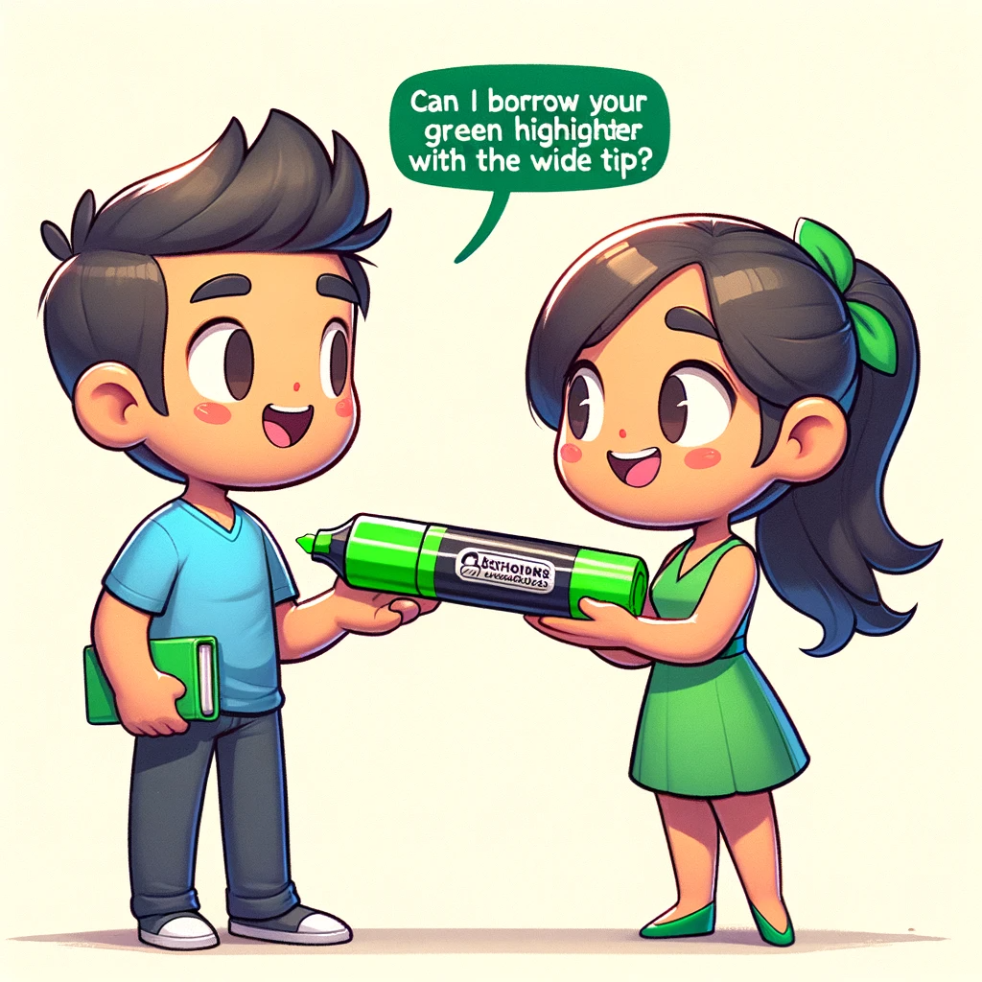

Slide 6
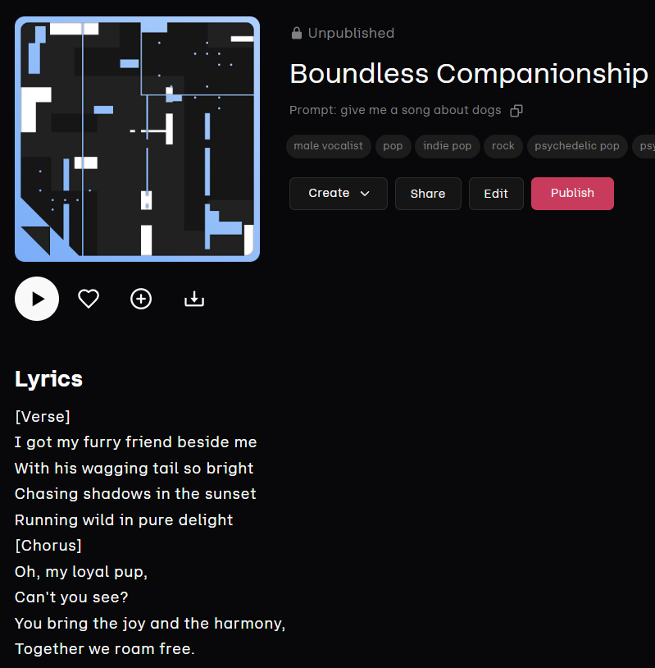
Being Vague
Notes:
Give me a song about dogs

Slide 7
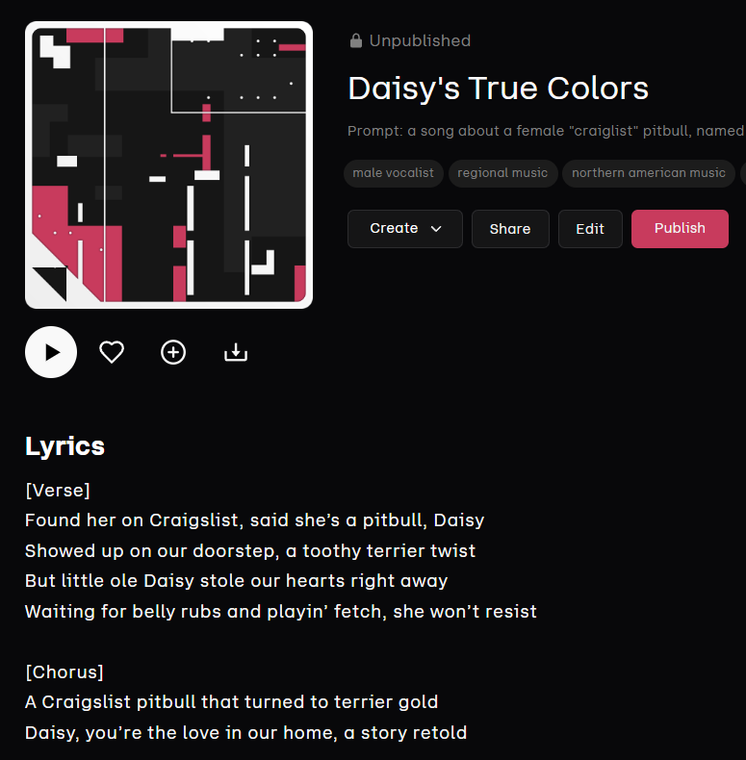
Being Precise
Notes:
Give me a song about a female "craiglist" pitbull, named Daisy, that turned out to be a rat terrier and became the most loved dog in the family, old 70's country in the style of George Strait

Slide 8
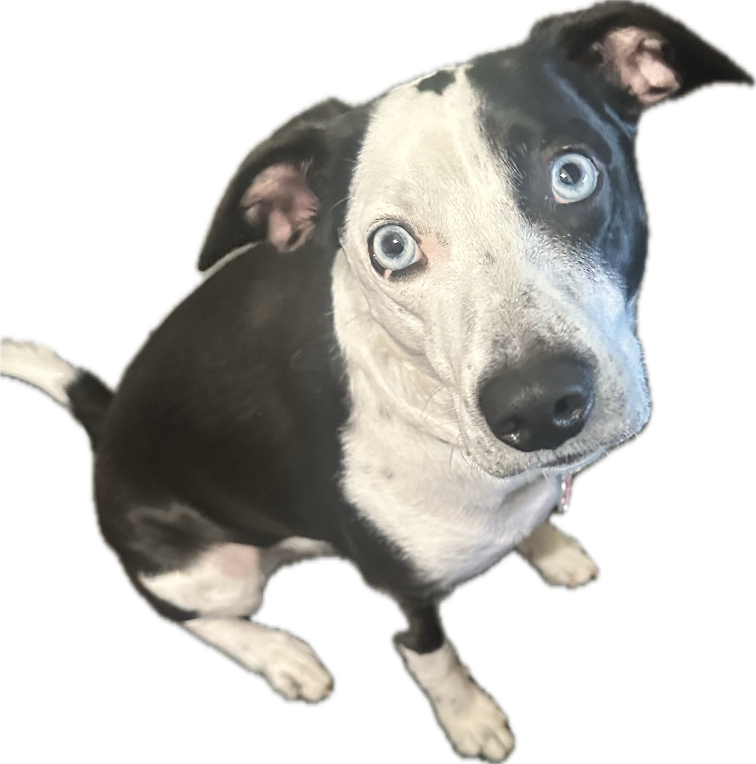

Slide 9




Notes:
https://www.youtube.com/channel/UC35ZpwldGw7ZJ5R-2sLijzw

Slide 10


Membership has its privileges
Notes:
https://www.youtube.com/channel/UC35ZpwldGw7ZJ5R-2sLijzw/join

Slide 11

https://www.youtube.com/@AINewsFresh

Slide 12
Creating music

Slide 13
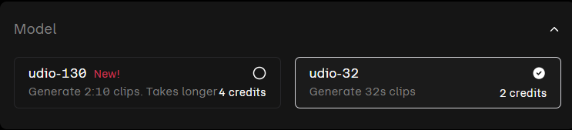
Choosing your model for length

Slide 14
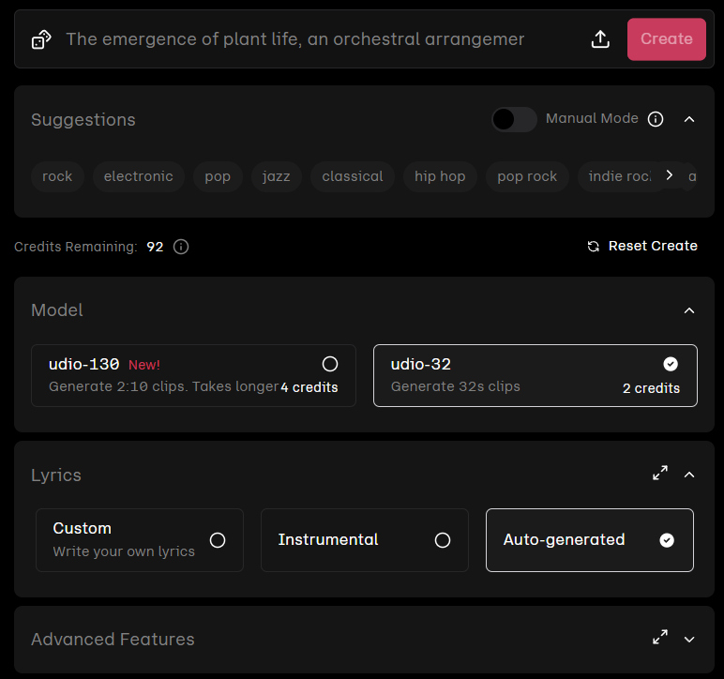
Notes:
https://www.udio.com/create

Slide 15
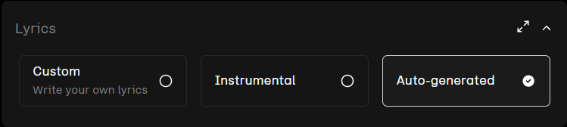
Creating a Song with auto-generated lyrics

Slide 16
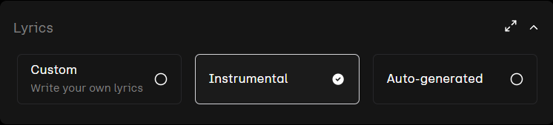
Creating an instrumental Song

Slide 17
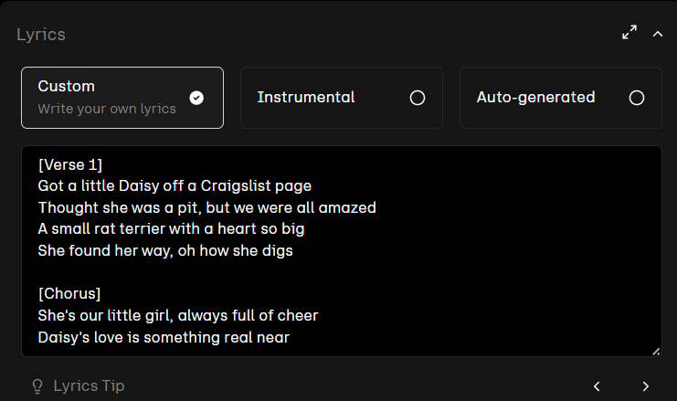
Creating a Song with custom lyrics

